Slide 1
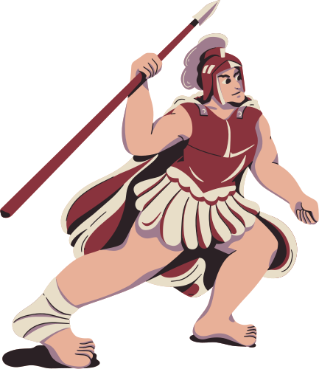


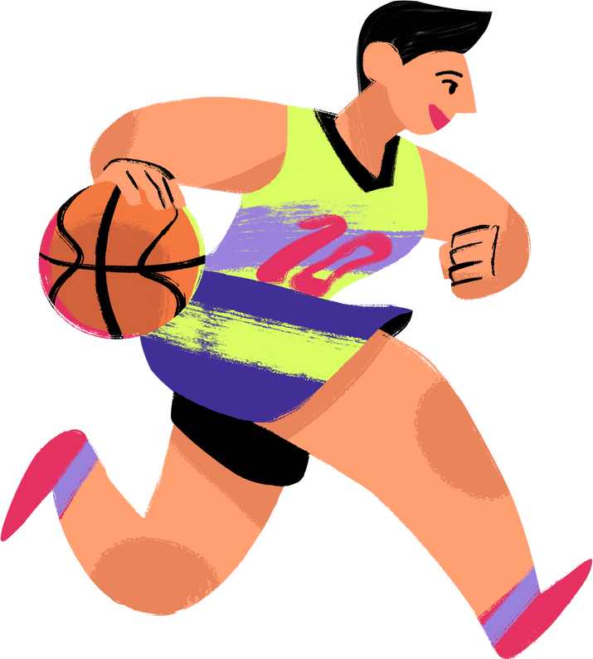
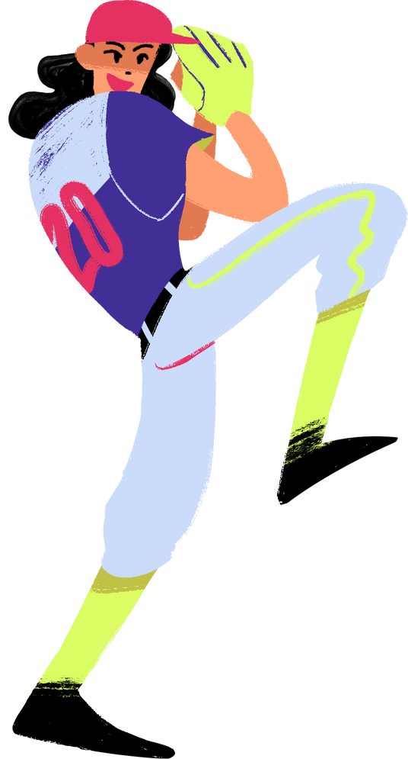
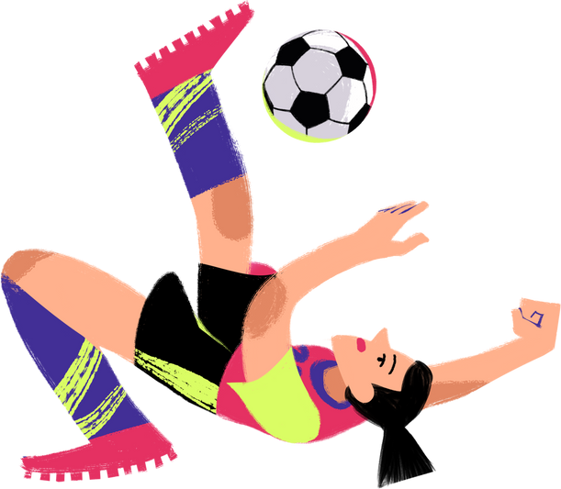
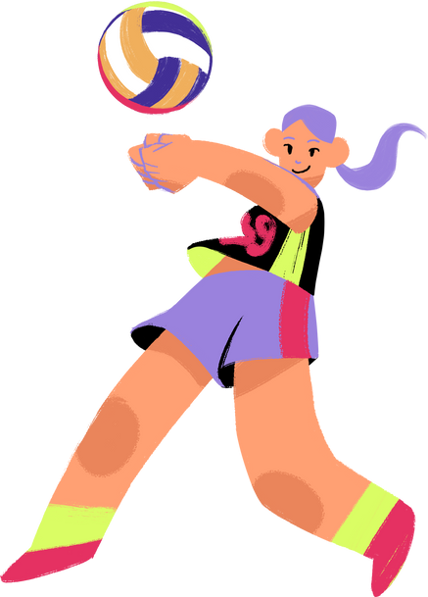
epl analysis
PRESENTED BY:
ANGEL ASBEURY-FILIPINI
ALICIA RAMOS PEREZ
AURISABEL FEREIRA

Slide 2
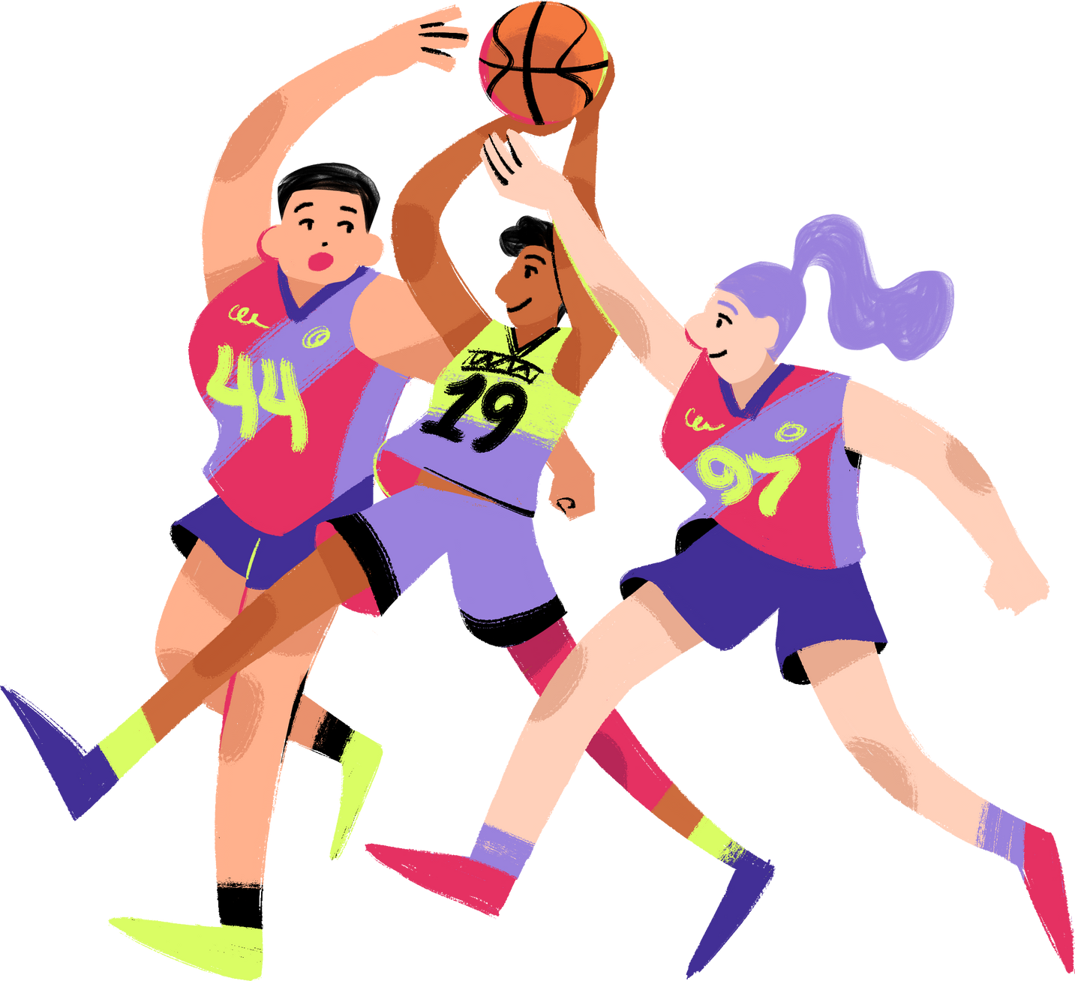
intro:
the goal
01
The goal of this project is to derive actionable insights that are meant to enhance EPL (English Premier League) performance as a data chief for this sports organization. We will be using our PLSquadPassingStats 2022-2023 dataset and Tableau to illustrate our findings.
02
We aim to identify the optimal playing styles for the teams to secure a top 7 finish or 4 to qualify for the Championss League.
03
By presenting these findings to stakeholders, we seek to develop a strategy for winning more games and achieving our targets for the next seasons to come.

Slide 3
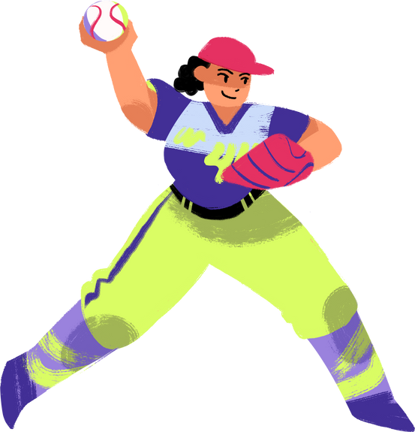
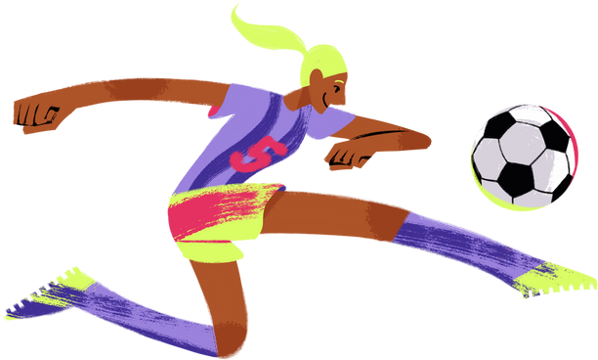
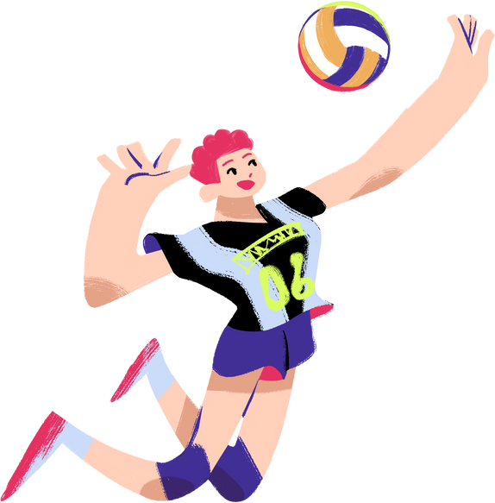
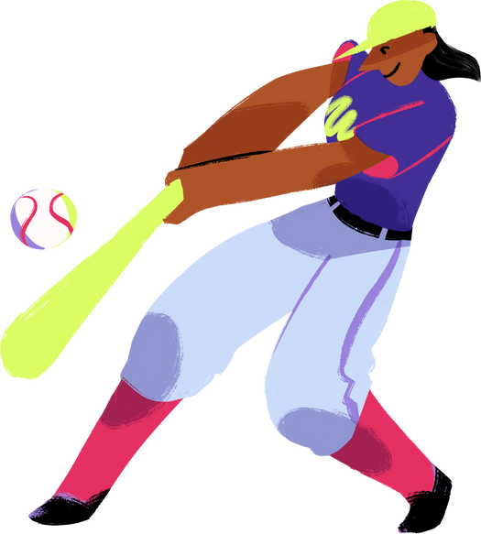
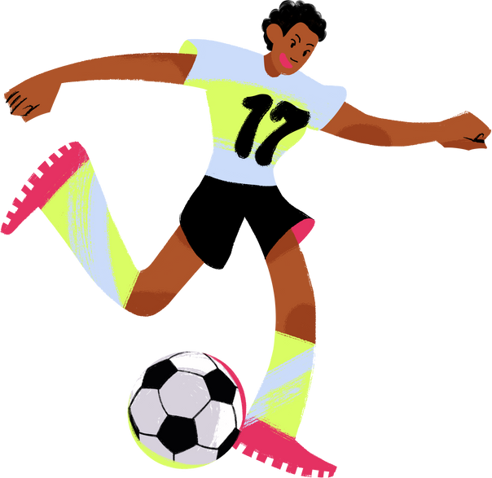
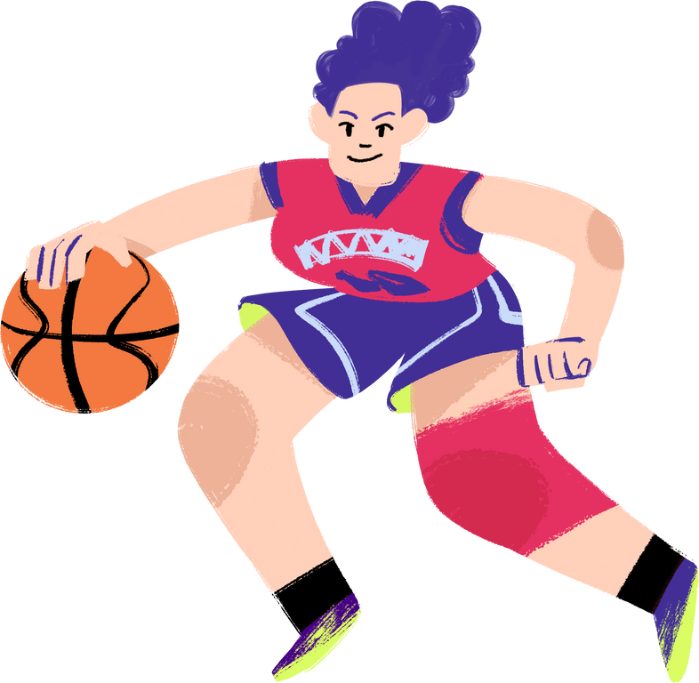
playing style:
Dynamic progressive possession
Dynamic Progressive Possession for the team to enhance their chances of success in the Premier League.
We can implement a strategic approach that combines maintaining possession of the ball with a high tempo, fluid movement, and proactive play.

Slide 4
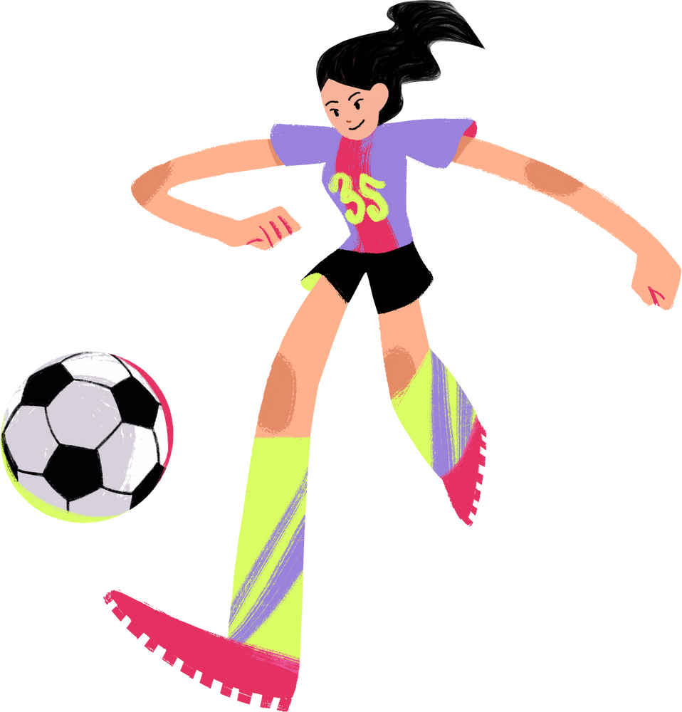
Formation
We will choose a 4-3-3 formation that is often used in a dynamic possession based football.
This formation provides a solid balance between defense and attack and allows for fluidity and flexibility in both phases of play.

Slide 5
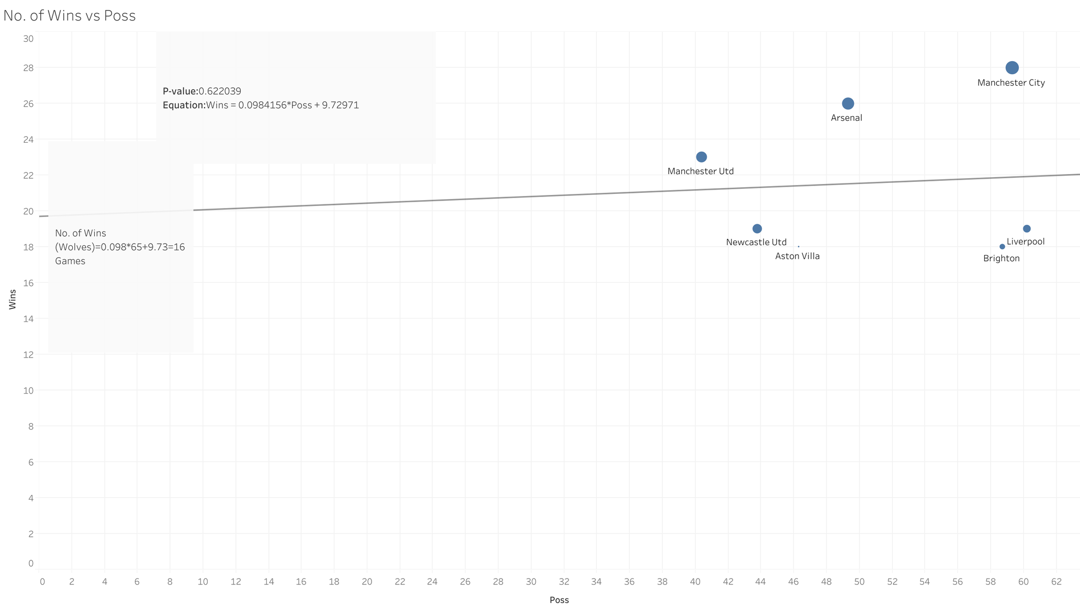

Slide 6
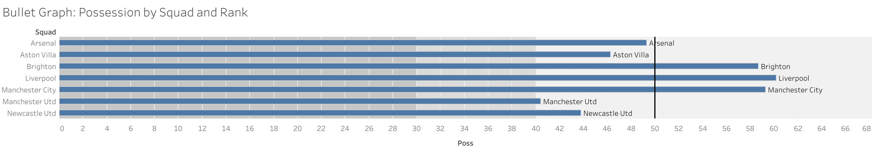

Slide 7
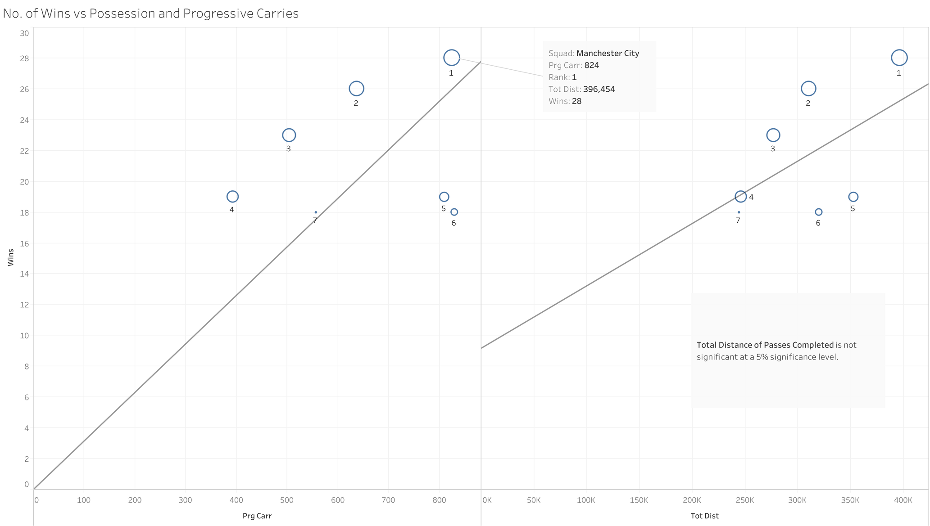

Slide 8
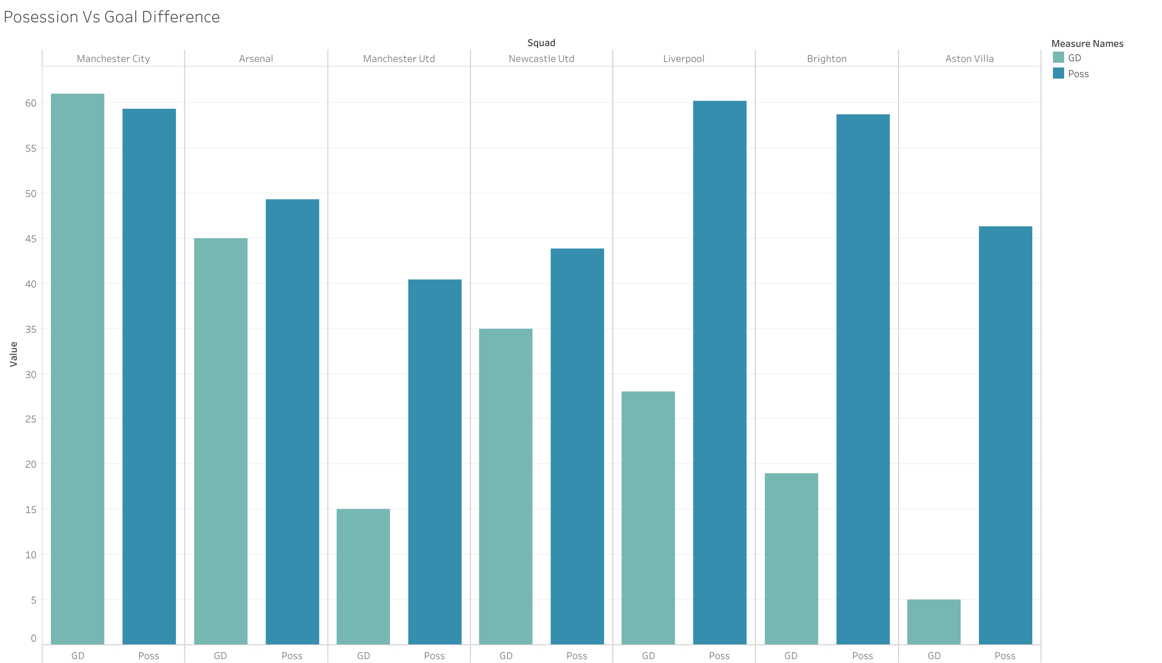

Slide 9
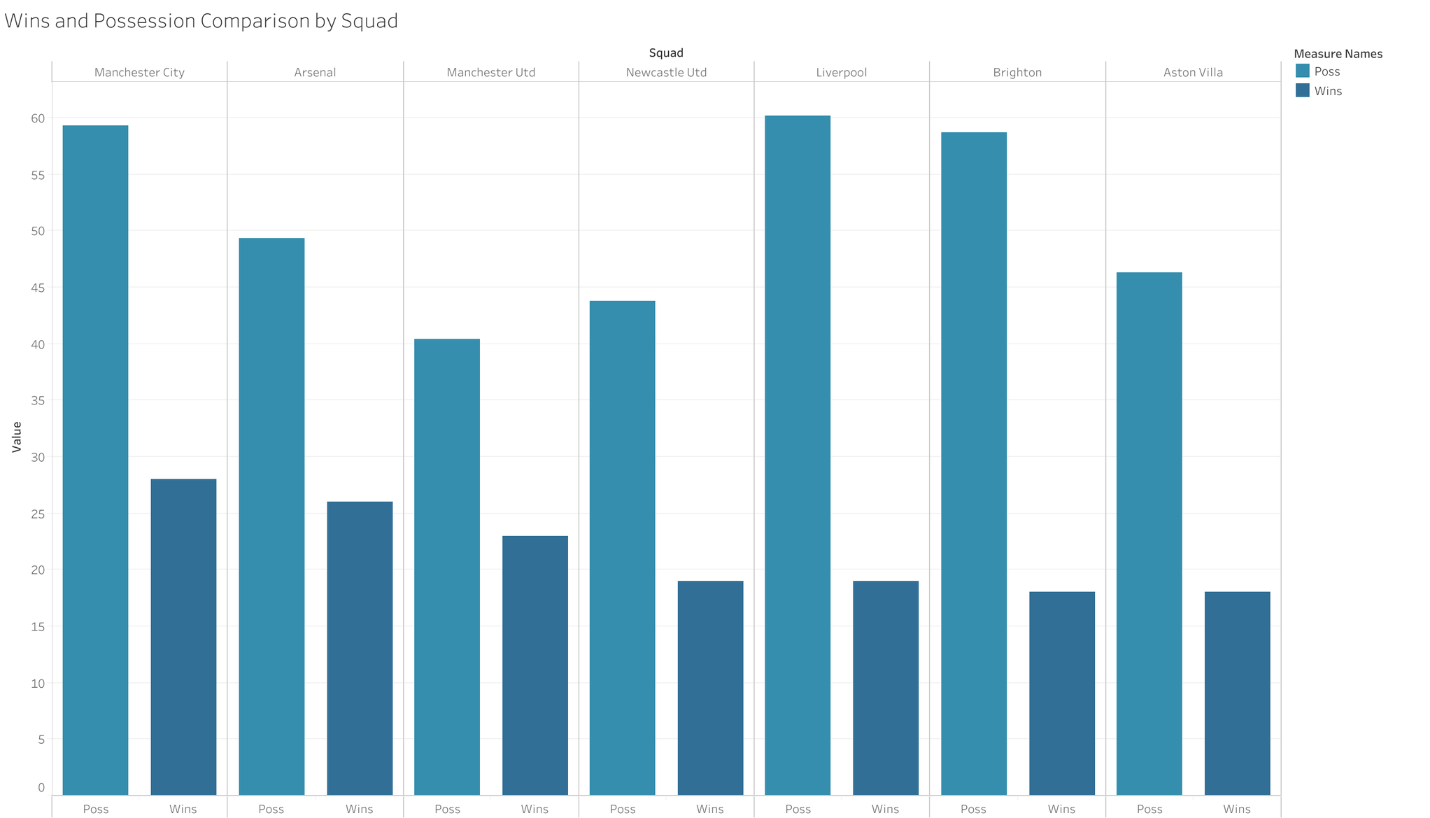

Slide 10
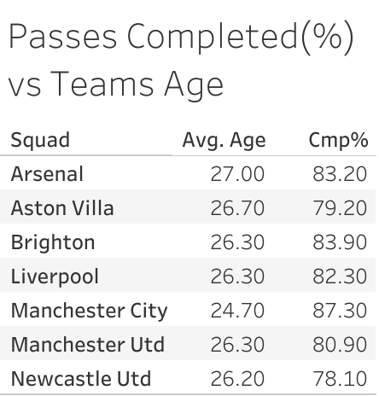

Slide 11
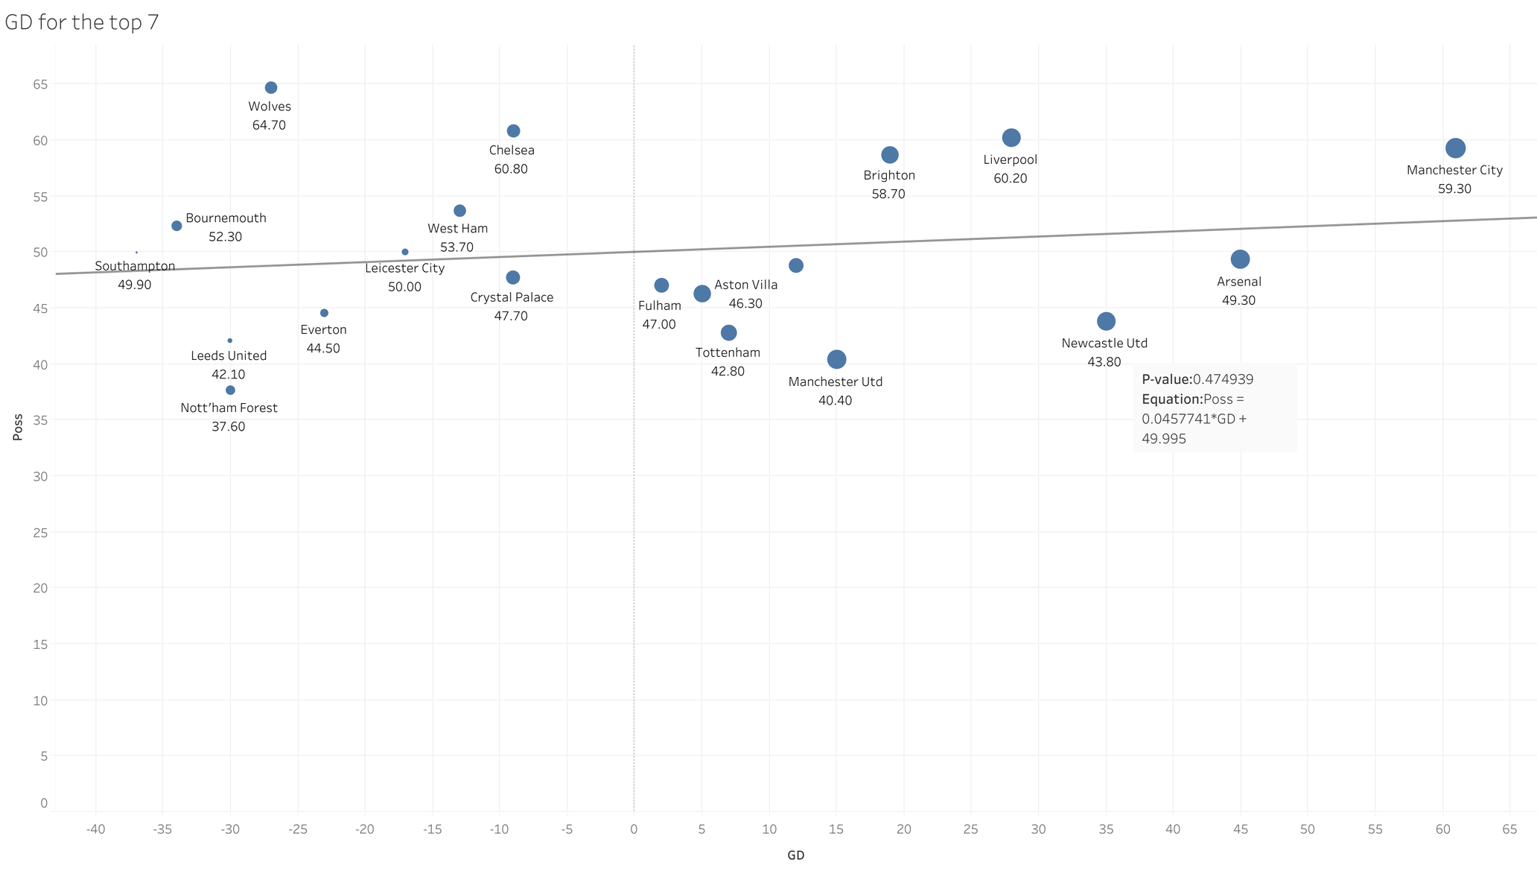

Slide 12
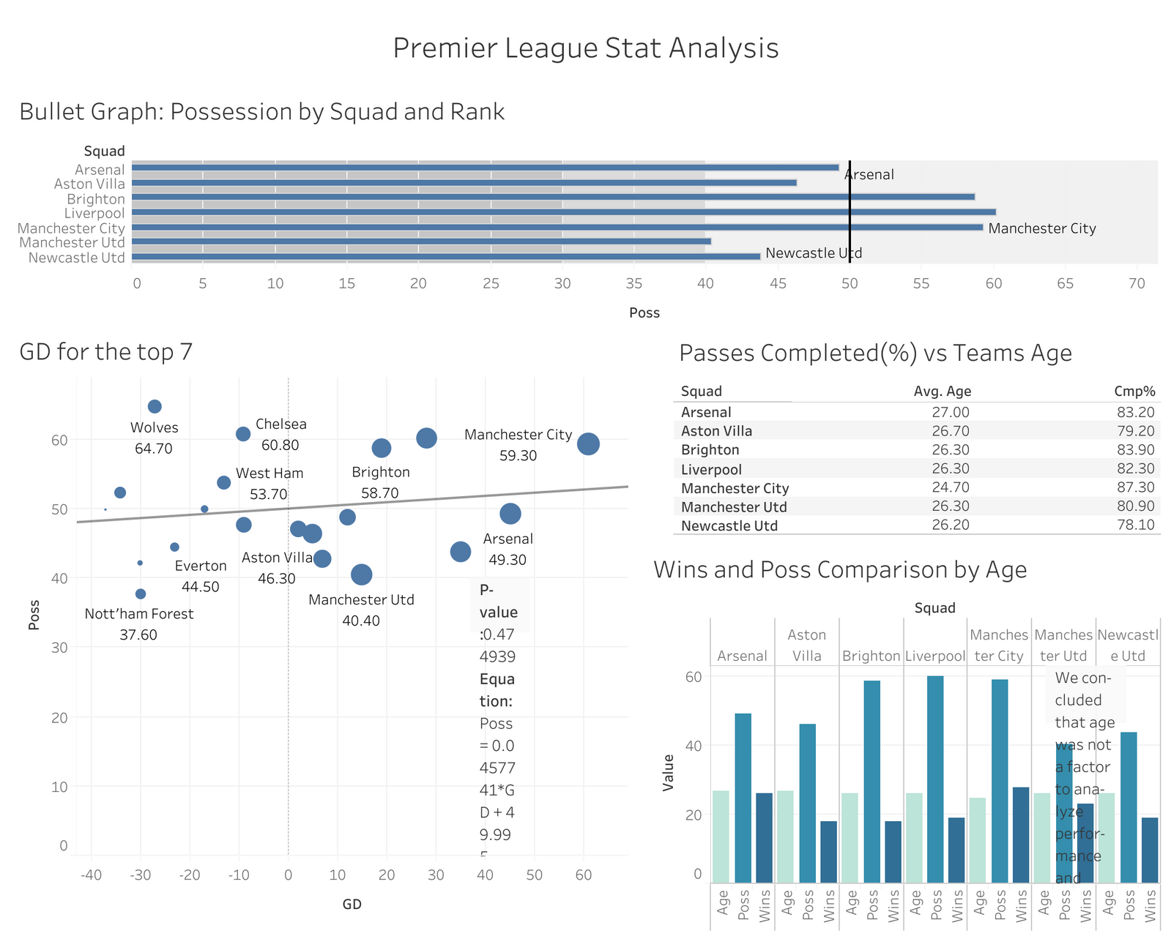

Slide 13
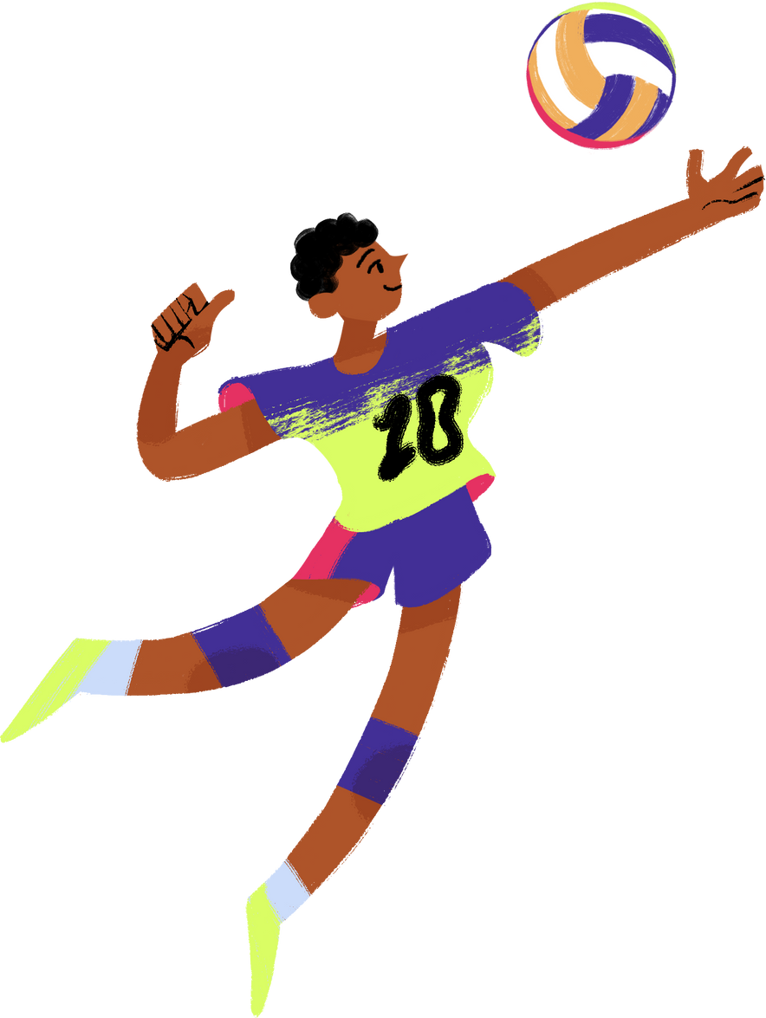
age: RELEVANCE?
Our analysis examined three key relationships for the top 7 Premier League teams: passes completed percentage versus team age, wins versus possession percentage, and the combined impact of possession, wins, and squad age.
No significant trends were observed between team age and passes completed percentage or between squad age and performance.
Additionally, possession percentage was not a statistically significant predictor of success among the top teams.

Slide 14
findings & recommendations
Our analysis recommends adopting a Dynamic Progressive Possession playing style, emphasizing possession, high tempo, and proactive play, using formations like 4-3-3 or 4-2-3-1.
The strategy includes:
Scouting younger players
Prioritizing experienced defenders for high possession
Increasing progressive passes
Aiming for a goal difference of at least 19 to enhance scoring opportunities and defensive stability.
These tactics aim to improve the team's chances of finishing in the top 7 and qualifying for European competitions.

Slide 15

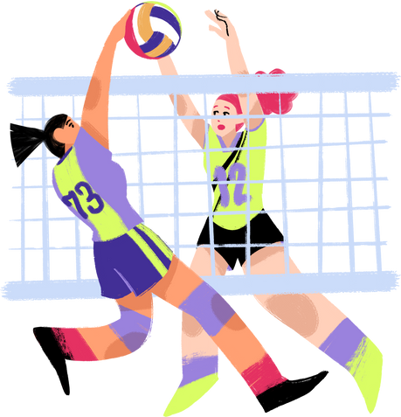
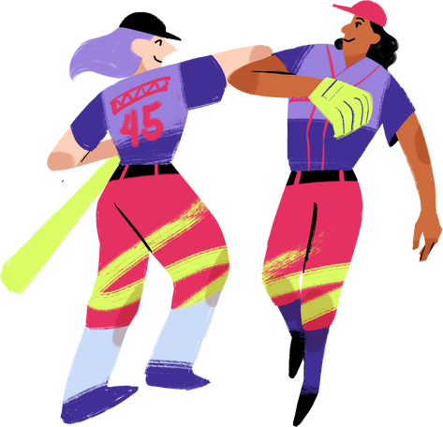
thank you!

